Slide 1

THIS WE'LL DEFEND
WHOLESALE HOLIDAY 2026
L O O K B O O K
21 STYLES • MEN'S & WOMEN'S • TEES & HOODIES

Slide 2
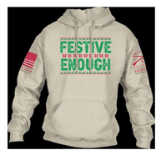
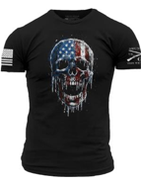
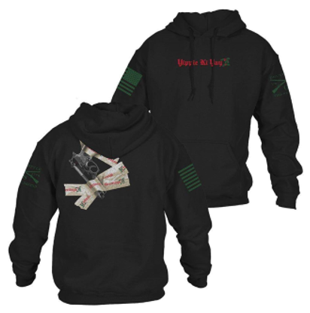
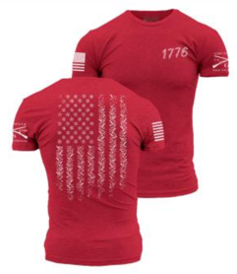
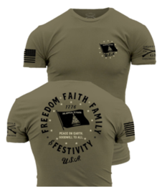

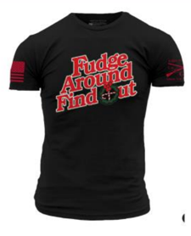
MEN'S HOODIES
WHOLESALE $23.99 | MSRP $47.99 | MSRP KEEPS MAP INTACT
GS8256
GS8309
Festive Enough Hoodie
Frosty Reaper Hoodie
Colorway: Sand
Colorway: Black
GS4840
GS8560
Yippee Ki Yay 2.0 Men's Hoodie
1776 Flag Christmas Hoodie
Colorway: Black
Colorway: Red
GS8567
GS8570
Festivity Hoodie
Let's Ride Hoodie
Colorway: Military Green
Colorway: Black
GS8572
Fudge Around And Find Out Hoodie
Colorway: Black
GRUNT STYLE // THIS WE'LL DEFEND
PG. 02

Slide 3
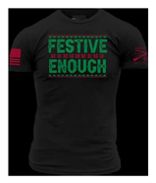
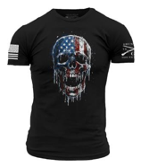
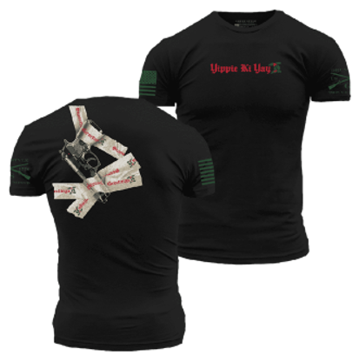
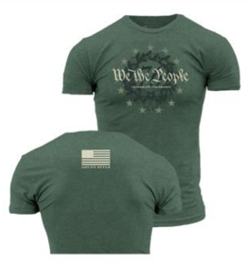
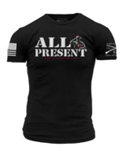
MEN'S TEES // 1 OF 2
WHOLESALE $14.99 | RETAIL $29.99 | MSRP KEEPS MAP INTACT
GS8297
GS8308
Festive Enough T-Shirt
Frosty Reaper T-Shirt
Colorway: Black
Colorway: Black
GS6628
GS8557
Yippee Ki Yay 2.0 T-Shirt
We The People Christmas T-Shirt
Colorway: Black
Colorway: Heather Forest Green
GS8559
GS8563
1776 Flag Christmas T-Shirt
All Present T-Shirt
Colorway: Red
Colorway: Black
GRUNT STYLE // THIS WE'LL DEFEND
PG. 03

Slide 4
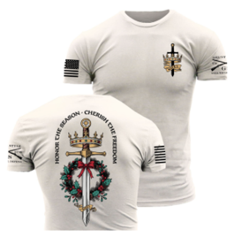
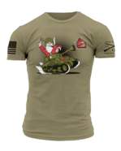
MEN'S TEES // 2 OF 2
WHOLESALE $14.99 | RETAIL $29.99 | MSRP KEEPS MAP INTACT
GS8566
GS8569
Festivity T-Shirt
Let's Ride T-Shirt
Colorway: Military Green
Colorway: Black
GS8571
GS8542
Honor The Season T-Shirt
Santa Slays T-Shirt
Colorway: Sand
Colorway: Military Green
GS8528
Fudge Around And Find Out T-Shirt
Colorway: Black
GRUNT STYLE // THIS WE'LL DEFEND
PG. 04

Slide 5
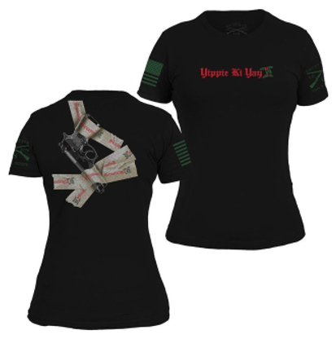
WOMEN'S
WHOLESALE $14.99 | RETAIL $29.99 | MSRP KEEPS MAP INTACT
GS5232
GS8568
Yippee Ki Yay Women's Slim Fit T-Shirt
Women's Festivity Slim Fit T-Shirt
Colorway: Black
Colorway: Military Green
GS8573
Women's Fudge Around And Find Out Slim Fit T-Shirt
Colorway: Black
GRUNT STYLE // THIS WE'LL DEFEND
PG. 05

Slide 6
THIS WE'LL DEFEND
Ready to order? Use the Wholesale Order Form or contact your Grunt Style rep.
GRUNT STYLE // THIS WE'LL DEFEND
PG. 06

